Slide 1
Part 2
Select… from… where query

Slide 2
Basic Query Structure
The SQL data-manipulation language (DML) provides the ability to query information, and insert, delete and update tuples
A typical SQL query has the form: select A₁, A₂, ..., A_{n} from r₁, r₂, ..., r_{m} where P
A_{i} represents an attribute
R_{i} represents a relation
P is a predicate.
The result of an SQL query is a relation.
Notes:
2
2

Slide 3
The select Clause
The select clause list the attributes desired in the result of a query
corresponds to the projection operation of the relational algebra
Example: find the names of all instructors: select name from instructor
NOTE: SQL names are case insensitive (i.e., you may use upper- or lower-case letters.)
E.g. Name ≡ NAME ≡ name
Some people use upper case wherever we use bold font.
Notes:
3
3

Slide 4
Queries on a Single Relation
select name from instructor;

Slide 5
Select dept_name from instructor;

Slide 6
The select Clause (Cont.)
SQL allows duplicates in relations as well as in query results.
To force the elimination of duplicates, insert the keyword distinct after select.
Find the names of all departments with instructor, and remove duplicates
select distinct dept_name from instructor
The keyword all specifies that duplicates not be removed.
select all dept_name from instructor
Notes:
6
4
Relational algebra language treats relation and result of a relation as a set, hence it removes the duplicates.
When we apply Set operations then r and result of query are treated as a set. Other operation treats it as Multi-set.

Slide 7
The select Clause (Cont.)
An asterisk in the select clause denotes “all attributes”
select * from instructor
The select clause can contain arithmetic expressions involving the operation, +, –, ∗, and /, and operating on constants or attributes of tuples.
The query:
select ID, name, salary/12 from instructor
would return a relation that is the same as the instructor relation, except that the value of the attribute salary is divided by 12.
Notes:
7
5

Slide 8
The where Clause
The where clause specifies conditions that the result must satisfy
Corresponds to the selection predicate of the relational algebra.
To find all instructors in Comp. Sci. dept with salary > 80000
select name from instructor where dept_name = ‘Comp. Sci.' and salary > 80000
Comparison results can be combined using the logical connectives and, or, not
Comparisons can be applied to results of arithmetic expressions.
Notes:
8
6
Examples: ICT or CSE
Dept_name <> CSE
Salary/12 > 80000

Slide 9
workout
-- create a table
CREATE TABLE students ( id INTEGER PRIMARY KEY,
name TEXT NOT NULL,
gender TEXT NOT NULL);
-- insert some values
INSERT INTO students VALUES (1, 'Ryan', 'M');
INSERT INTO students VALUES (2, 'Joanna', 'F');
-- fetch some values
SELECT * FROM students WHERE gender = 'F';

Slide 10
Querying multiple tables
Looking at the schema of the relation instructor, we realize that we can get the department name from the attribute dept name, but the department building name is present in the attribute building of the relation department.
To answer the query, each tuple in the instructor relation must be matched with the tuple in the department relation whose dept name value matches the dept name value of the instructor tuple.

Slide 11
The from Clause
The from clause lists the relations involved in the query
Corresponds to the Cartesian product operation of the relational algebra.
Find the Cartesian product instructor X teaches
select ∗ from instructor, teaches
generates every possible instructor – teaches pair, with all attributes from both relations
Cartesian product not very useful directly, but useful combined with where-clause condition (selection operation in relational algebra)
Notes:
11
8

Slide 12
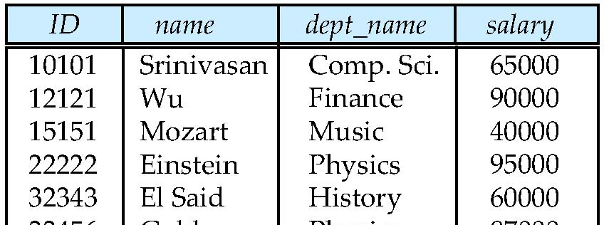
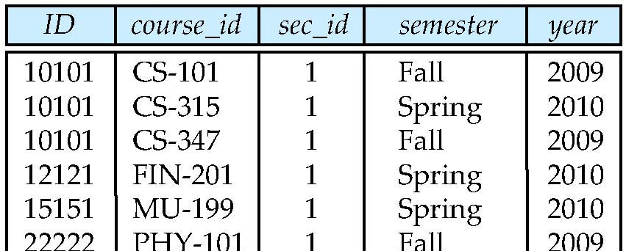
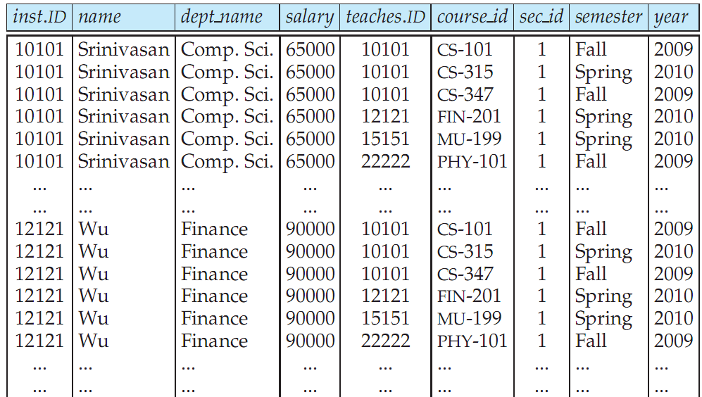
Cartesian Product: instructor X teaches
instructor
teaches

Slide 13

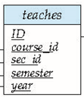
joins
For all instructors who have taught some course, find their names and the course ID of the courses they taught.
select name, course_id from instructor, teaches where instructor.ID = teaches.ID

Slide 14
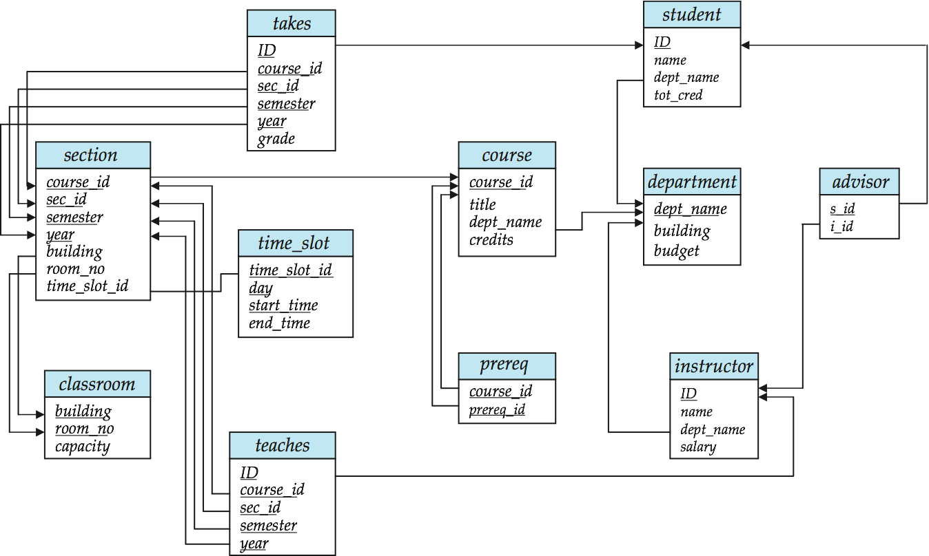
Joins
Find the course ID, semester, year and title of each course offered by the Comp. Sci. department
select section.course_id, semester, year, title from section, course where section.course_id = course.course_id and dept_name = ‘Comp. Sci.'
Notes:
1. Generate a Cartesian product of the relations listed in the from clause
2. Apply the predicates specified in the where clause on the result of Step 1.
3. For each tuple in the result of Step 2, output the attributes (or results of
expressions) specified in the select clause.

Slide 15
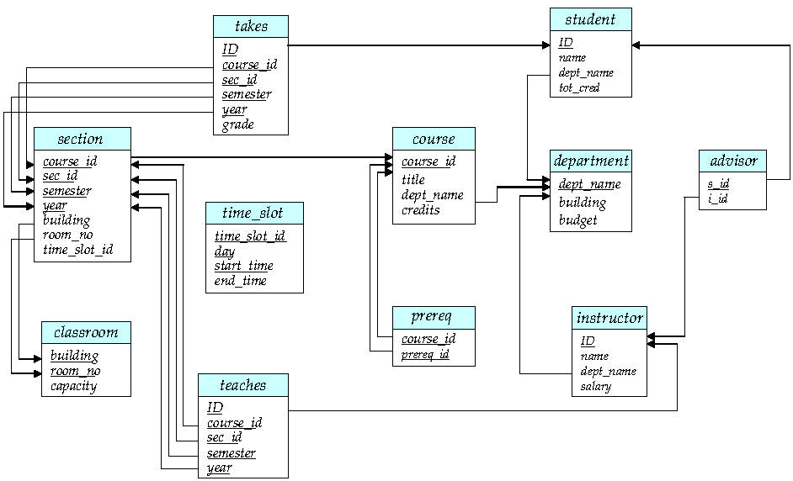
Try Writing Some Queries in SQL
Notes:
Display id of students who have taken the course offered by physics department
List out the 4 credit courses offered by ICT department
Display names of all advisors from Maths department
What would result if we give 10% salary hike to all instructors?Display name and Raised new salary.
Retrieve the names of all instructors, along with their department names and department building
name.
Display Student and their respective advisor information
Display Course and its prerequisite information
Display the computer science courses which are held in room no=105 and building AB5
Display the student’ details who scored A or A+ grade in DBS course.

Slide 16
1.Display id of students who have taken the course offered by physics department
2.List out the 4 credit courses offered by ICT department
3.Display names of all advisors from Maths department
4. Retrieve the names of all instructors, along with their department names and department building name.
5.Display Student and their respective advisor information
6.Display Course and its prerequisite information
7.Display the computer science courses which are held in room no=105 and building AB5
8. Display the student’ details who scored A or A+ grade in DBS course.
(solution in doc file)

